Slide 1

Draft Predictor Project

Slide 2
Project Overview
The NBA draft predictor project will utilize Machine Learning by building a model that capture weights and relationships between features from historical data and then uses the model for predicting future NBA draft picks.

Slide 3
Team Members
Sean Carraher
Daniel Evans
Miguel Gomez
Patricia Johsz
Haidy Sedky

Slide 4
Technical Approach

Slide 5
Project flow

Slide 6
Project Data
Multiple input sources were considered for the project. In some cases the data source was deemed insufficient and was thus eliminated from the project.

Slide 7
Data Sources
NBA.COM (Advanced Stats/ Combine)
https://stats.nba.com/draft/history/
https://stats.nba.com/draft/combine-spot-up/
https://stats.nba.com/draft/combine-non-stationary/
https://stats.nba.com/draft/combine-strength-agility/
https://stats.nba.com/draft/combine-anthro/
Basketball Reference.Com (Drafted)
https://www.basketball-reference.com/draft/NBA_2018.html
draftedPlayers20092017.csv
Sports Reference.Com (Undrafted)
https://www.sports-reference.com/cbb/seasons/
undraftedPlayers20092017.csv
Real GM (Drafted and Undrafted Player Data)
https://basketball.realgm.com/nba/draft/past-drafts

Slide 8
Data Input Selection
NBA Draft Combine Statistics
Biometric Information
Draft History
Shooting (spot and non-stationary)
Strength and Agility
Past Draft Statistics
Biometric Information
Draft Results
College Career Data
The team reviewed multiple input files to determine which data attributes would best work with the data model.
Some of the input sources were eliminated due to data coverage.
Training / test data covers the 2009 – 2018 seasons.
Game Played
Games Started
Minutes Played
Field Goals
Field Goals Attempted
Field Goal %
2 Pt Field Goals
2 Pt Field Goal Attempts
2 Pt Field Goal %
3 Pt Field Goals
3 Pt Field Goal Attempts
3 Pt Field Goal %
Free Throws
Free Throw Attempts
Free Throw %
Total Rebounds
Assists
Steals
Blocks
Turnovers
Personal Fouls
Total Points

Slide 9
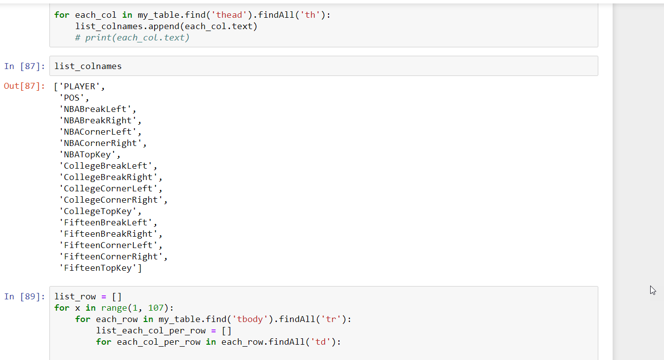
Data Capture
Looping through the data to locate the field header.

Slide 10
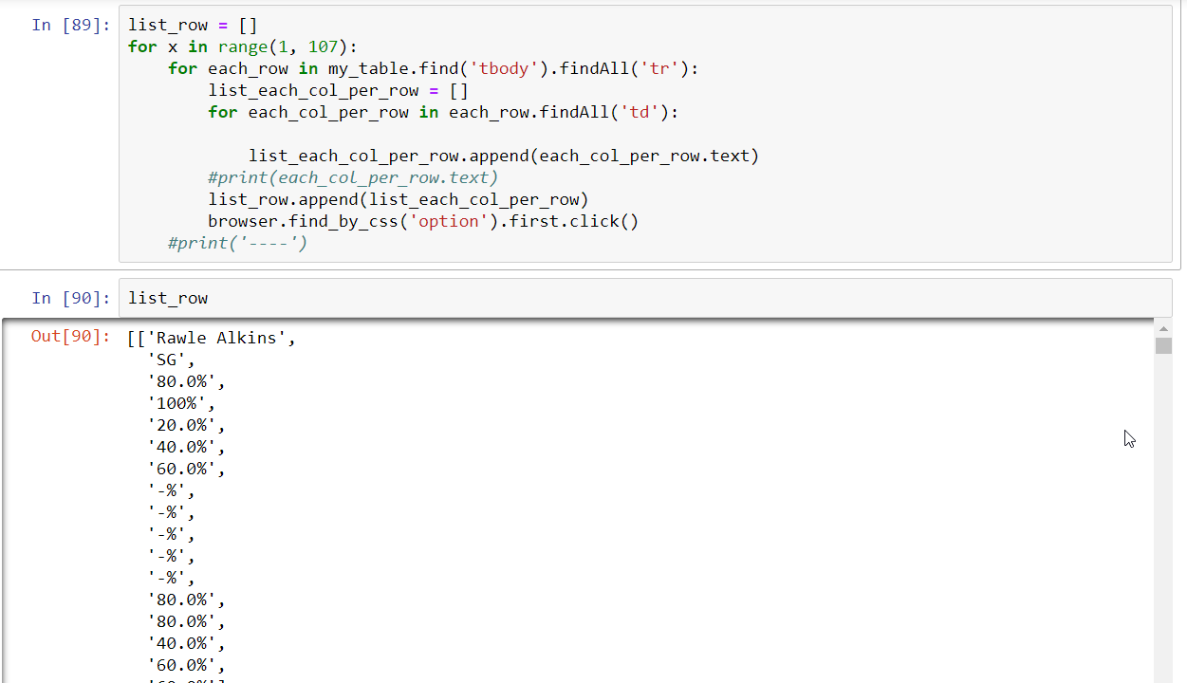

Slide 11
Data Clean Up

Slide 12
Data Manipulation
Beautiful soup was utilized for traversing html documents.
Openpyxl was used for load workbook.
Pandas was used for data manipulation.
Data Variables:
-addr : this is a list containing strings of the addresses needed to visit
-draftList : this is an empty list that will store player links
-page : holds requests object (this will be the html document that gets pulled)
-soup : holds BeautifulSoup object of the html document
-draftTbl : holds BeautifulSoup object which was the result of looking for a tbody tag and all the tr tags inside of that
-x : used as a counter for the loop
-divs : used to hold td tags from within the draftTbl variable
-ref : used to hold anchor tags from the divs variable
Beautiful Soup
Numpys
Pandas
Openpyxl

Slide 13
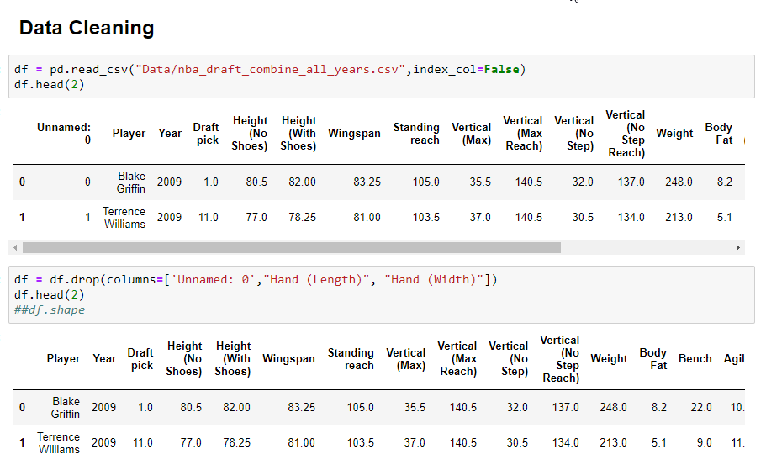

Slide 14
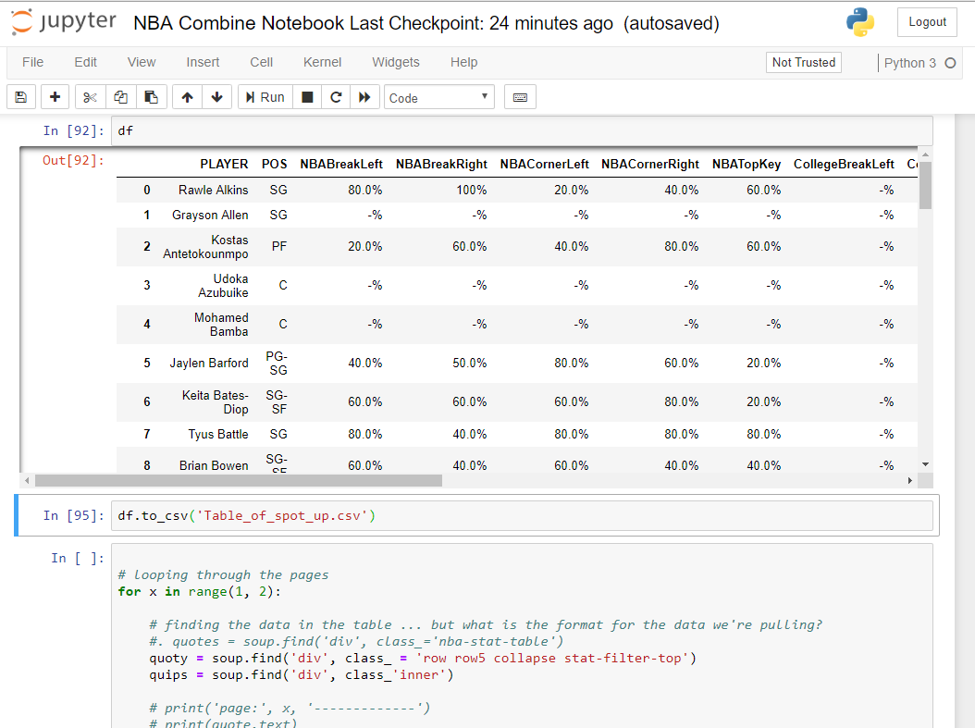

Slide 15
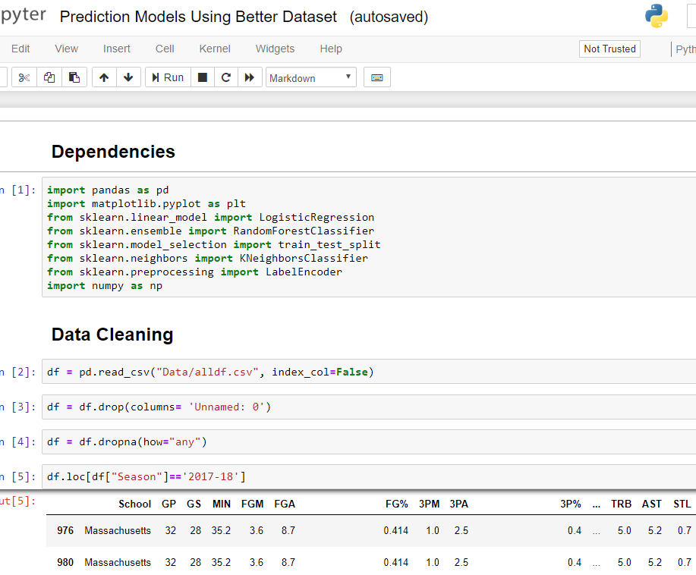
Data Cleaning
Second Input File

Slide 16
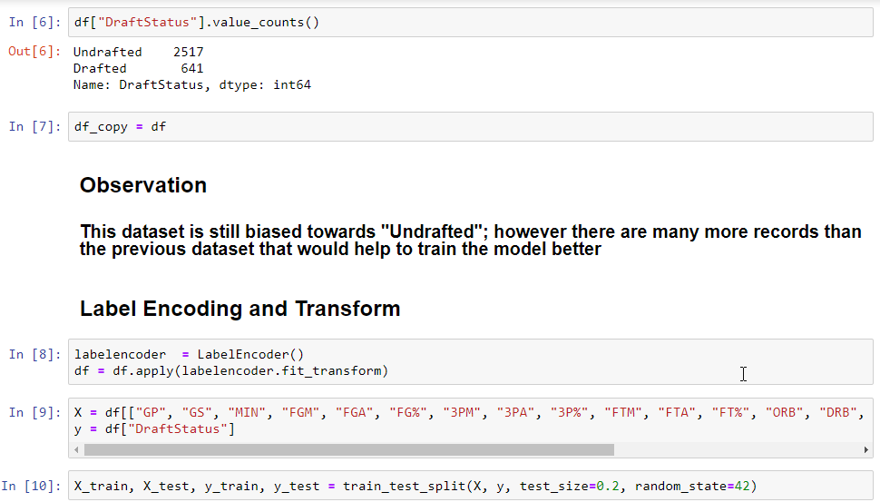

Slide 17
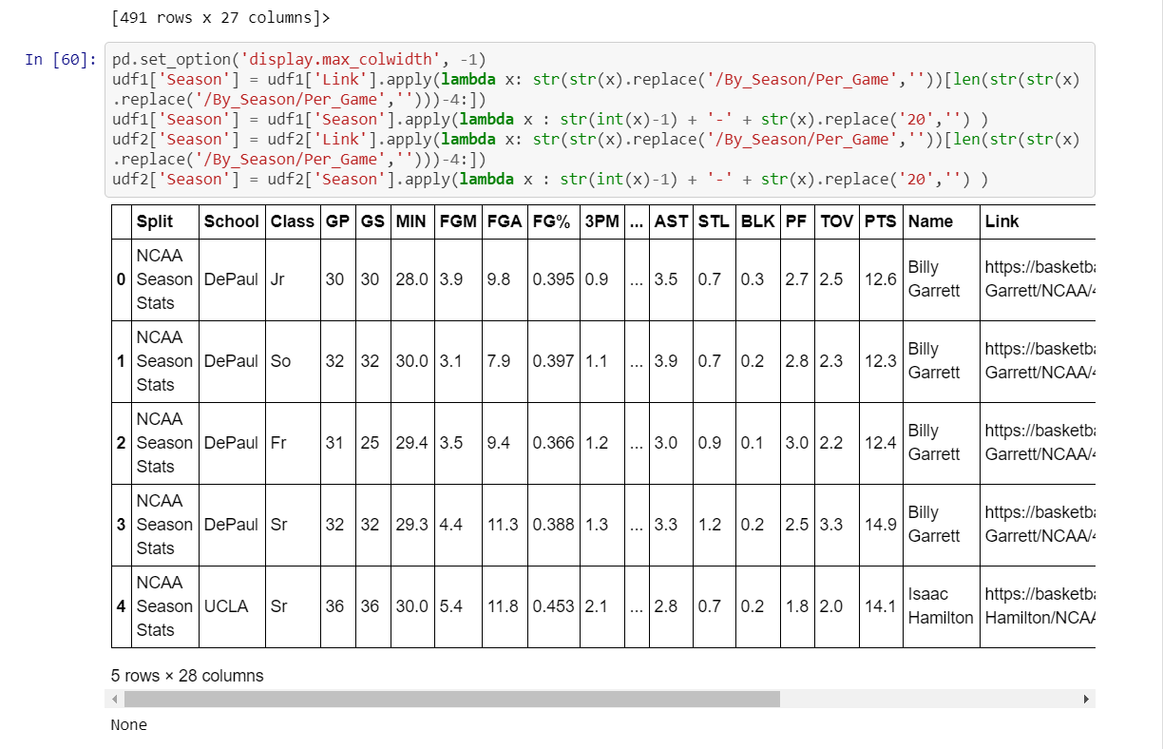

Slide 18
Machine Learning Library
Scikit-Learn was selected as the machine learning library for building the NBA Draft Predictor project.
The team experimented with three different models to determine which worked best for predicting future drafts based on historical performance.

Slide 19
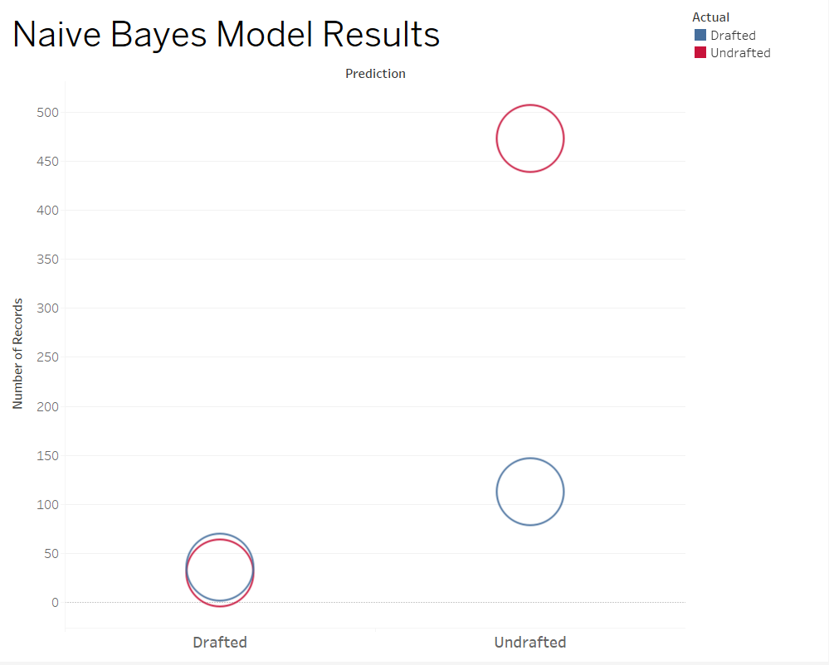
Model evaluation rules
Naive Bayes Model
A naive Bayes classifier is an algorithm that uses Bayes' theorem to classify objects. Naive Bayes classifiers assume strong, or naive, independence between attributes of data points.
Data Points used for the model included the following:
Field Goal Percentage

Slide 20
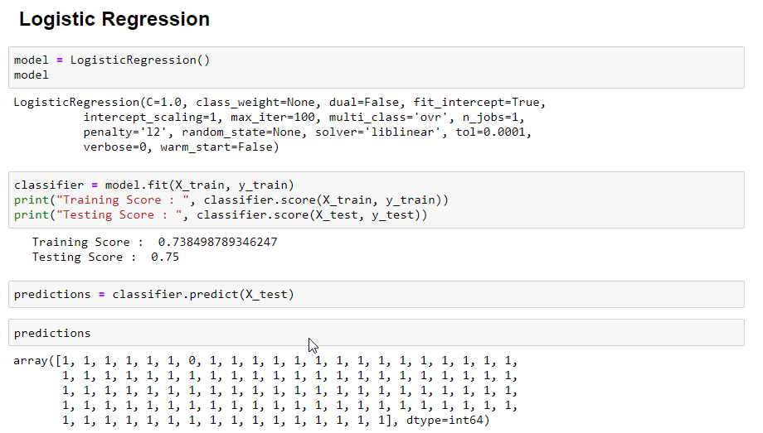
Model evaluation rules
Logistical Regression Model
Logistic Regression is a Machine Learning classification algorithm that is used to predict the probability of a categorical dependent variable.

Slide 21
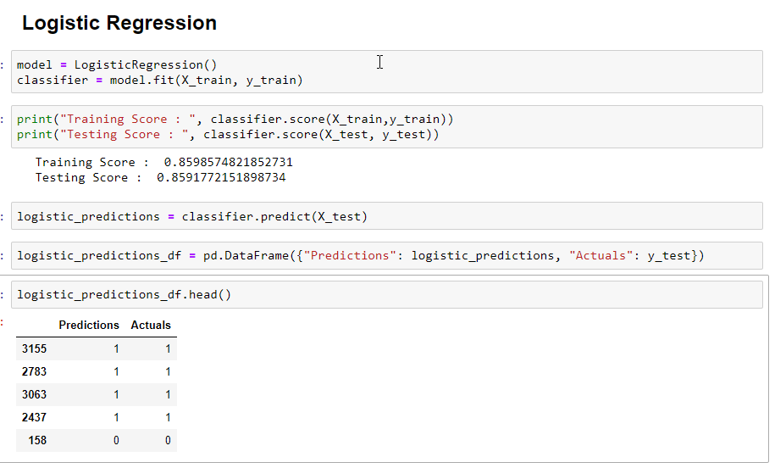
Logistic Regression
Using Second Input File

Slide 22
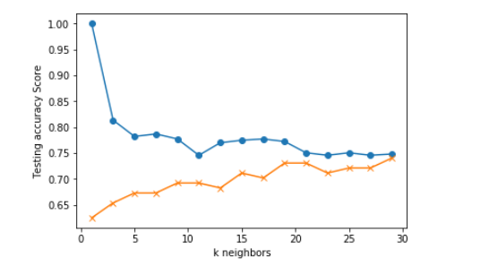
Model evaluation rules
KNN Model
In pattern recognition, the k-nearest neighbors algorithm (k-NN) is a non-parametric method used for classification and regression.

Slide 23
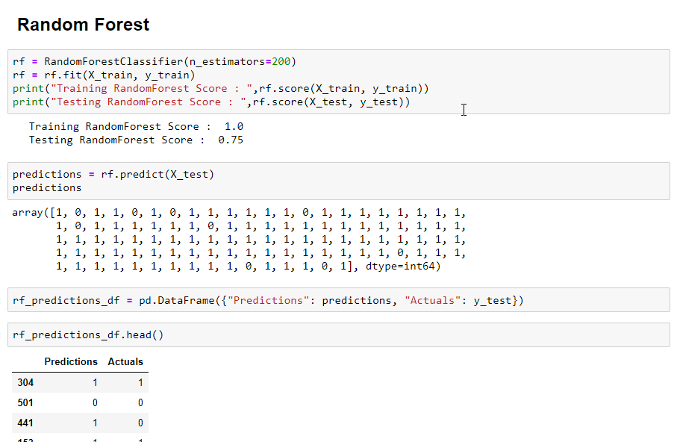
Model evaluation rules
Random Forests Model
A random forest is a meta estimator that fits a number of decision tree classifiers on various sub-samples of the dataset and uses averaging to improve the predictive accuracy and control over-fitting.
Data Points used for the model included the following:
"GP", "GS", "MIN", "FGM", "FGA", "FG%", "3PM", "3PA", "3P%", "FTM", "FTA", "FT%", "ORB", "DRB", "TRB", "AST", "STL", "BLK", "PF", "TOV“ and "PTS“

Slide 24
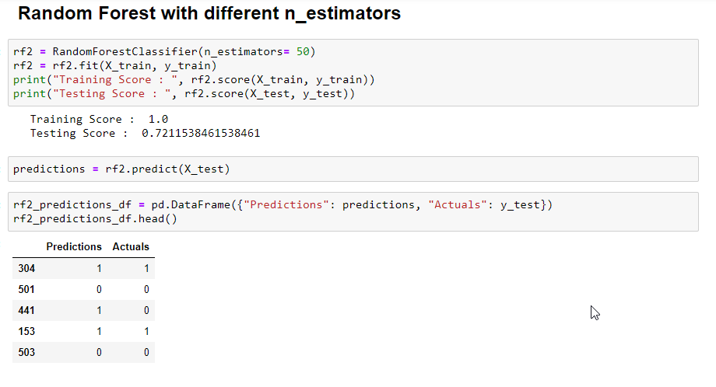
Random Forest
Using First Input File.

Slide 25
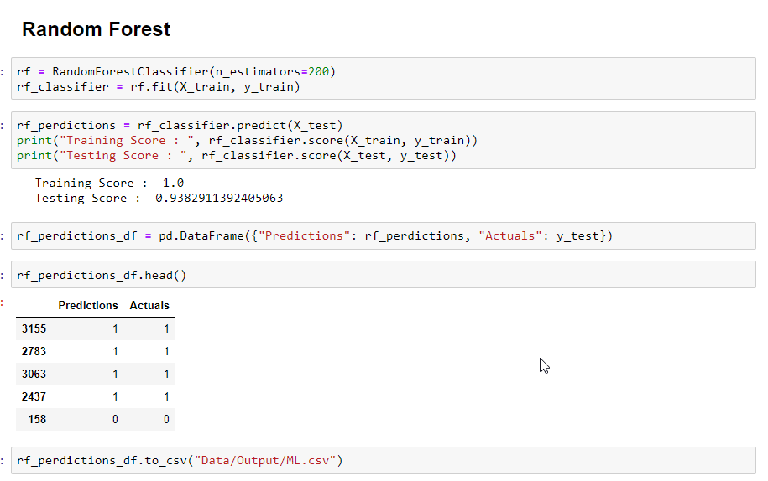
Random Forest
Using Second Input File
In this execution of the model the data was split by season prior to the execution of the model.
To predict the data for the season of 2017-2018 was considered the prediction

Slide 26
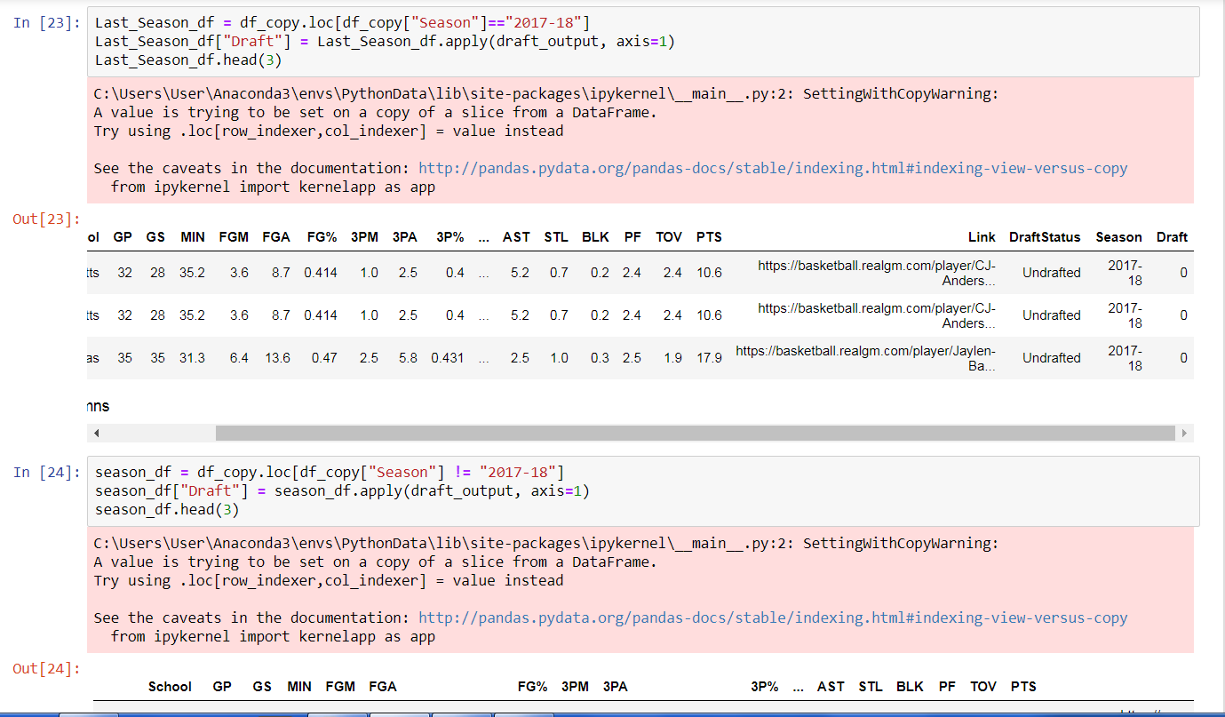
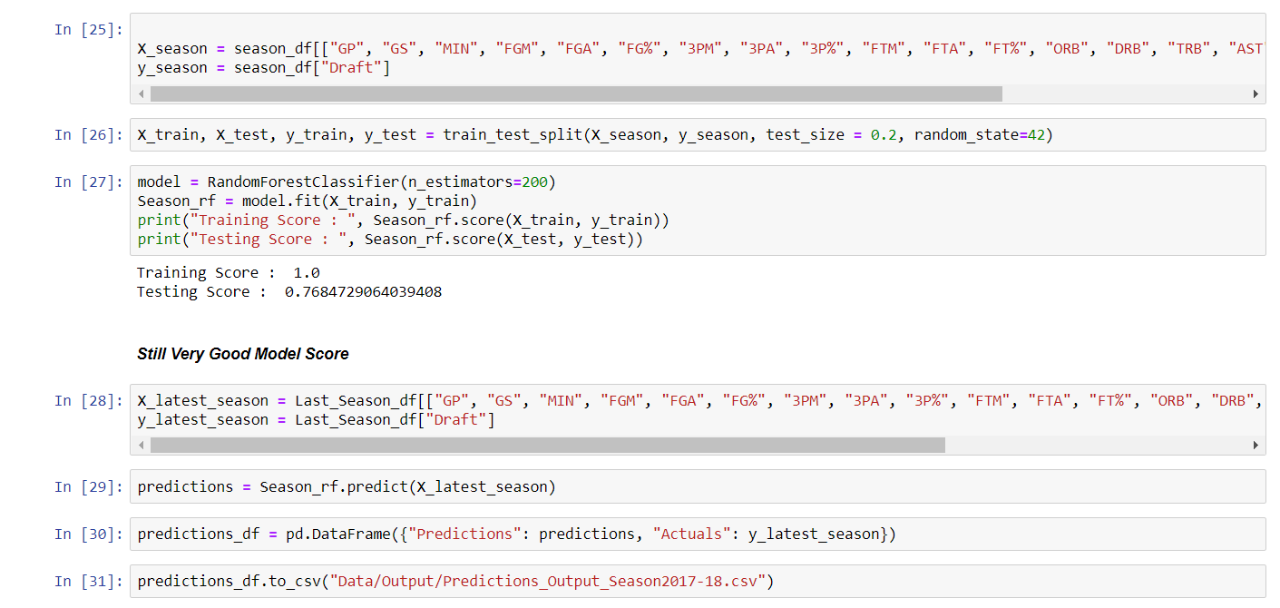

Slide 27
Conclusion
For the selected input dataset the best model was Random Forest due to the predictions being more accurate than the other models.
The dataset selected was not the best for model purposes as the score was not close to the value of 1.0.
Additional models using different categories of Drafted and Undrafted were more unbiased, therefore a better indicator for the project.
The effect of having a greater amount of data in the training dataset resulted in a significantly improved model result.

Slide 28


